Slide 2
Motivation
We got motivated by observing some of the concerns faced by instructors like For instructor its time taking to capture attendance manually in every class and observe each individual performance and interest on subject.
Objective:
To bring ease in tracking the attendance for instructors.

Slide 3
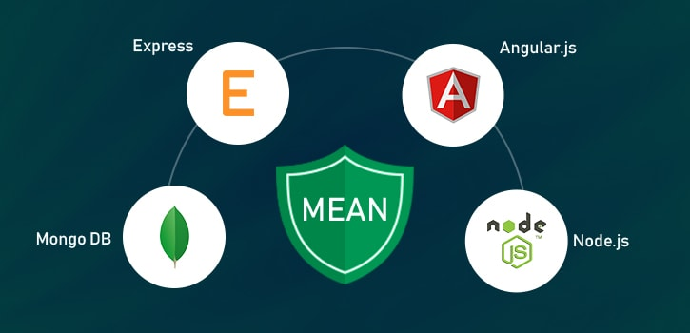

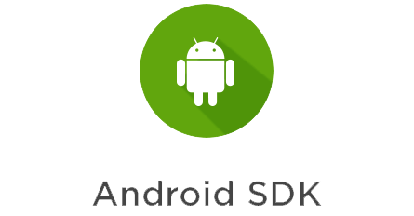

Implementation Environment
Mongo DB
Express.js
Angular 7
Node.js
Ionic 4
Android SDK
X-code
Heroku

Slide 4
Architecture

Slide 5
Challenges and Approaches and New findings
Problem
Solution
New QR code generation after every check in.
Deployment is needed for every change in backend.
Digitally signing apk is a cumbersome process
Socket implementation
Implemented CICD using GitHub and Heroku.
Hunted through google documentation.

Slide 6
trials and errors, recommendations if future students would pick up from your project
Ionic is old framework. React is trending technology to build mobile application.
Backend should be deployed separately to
We can generate apk file for Android application freely but need to payment ($25) to place in play store.
We need to pay($100+) even for generating apk file and also for placing app in apple store.

Slide 7
Journey
Iteration 1: Closed
Research on the core concepts related to the project
Design the system architecture
Ends with a follow up meeting with Professor to show the progress and get feedback.
Iteration 2: Closed
Implemented Below features:
Professor Login
Professor Report View
Generate QR Code by Professor
Student Attendance Scanning
Mark Attendance in Database
Testing in Android Phone
A follow up meeting with Professor to show the progress and get feedback (this gives the status of our application).

Slide 8
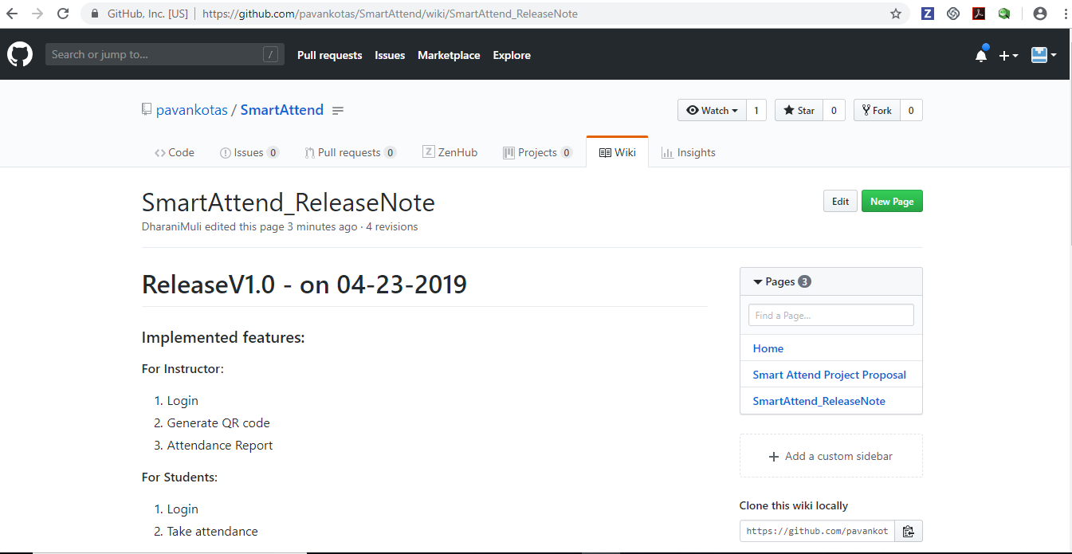
https://github.com/pavankotas/SmartAttend/wiki/SmartAttend_ReleaseNote

Slide 9
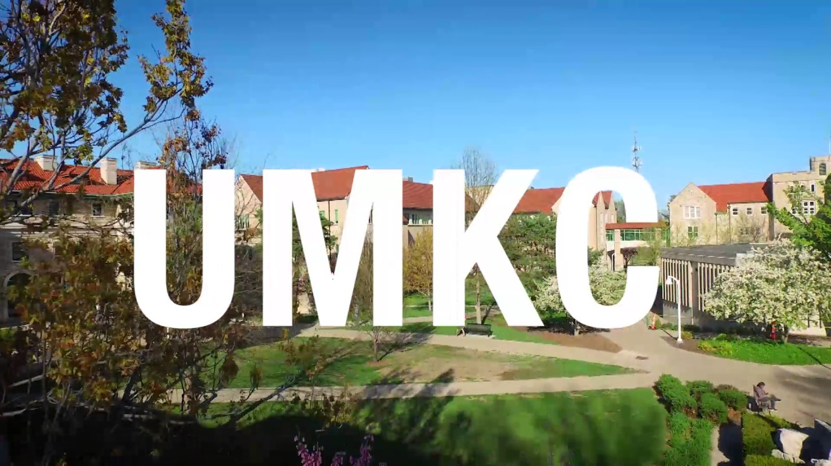
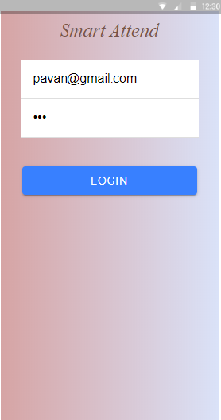
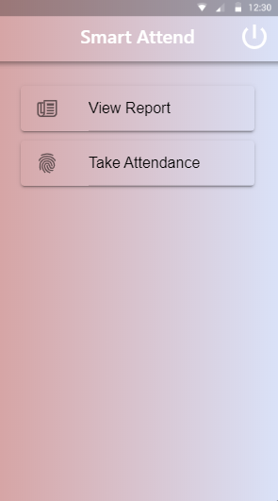
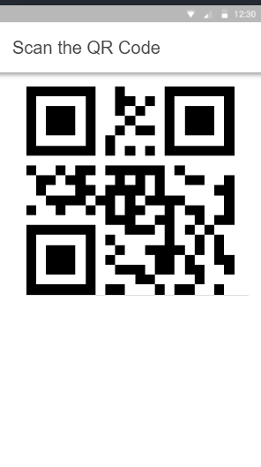
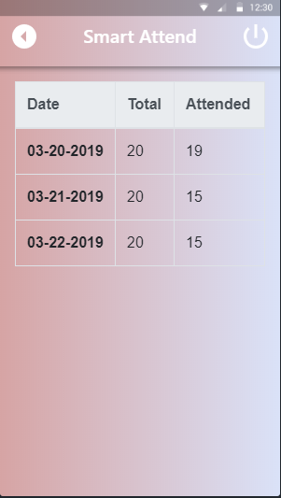
Professor Login
Home Page
Take Attendance
View Report

Slide 10
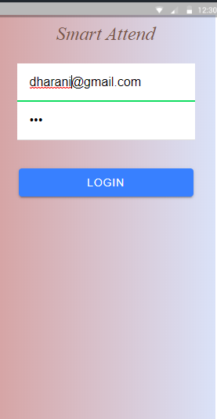
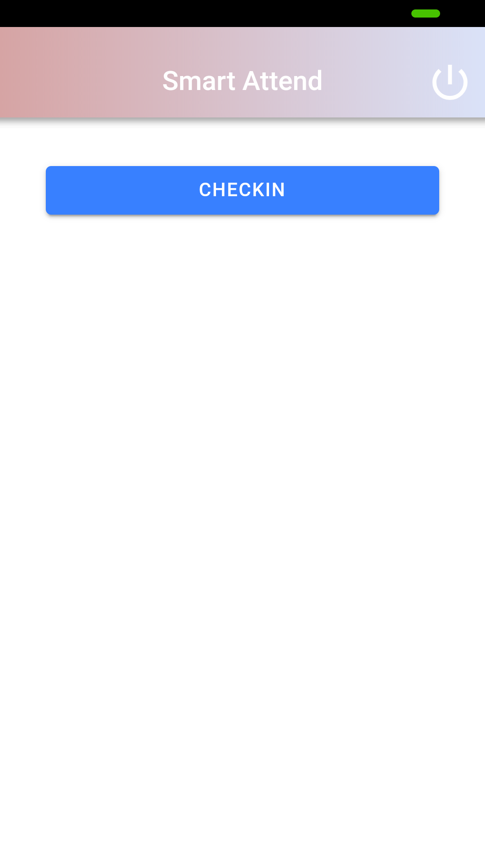
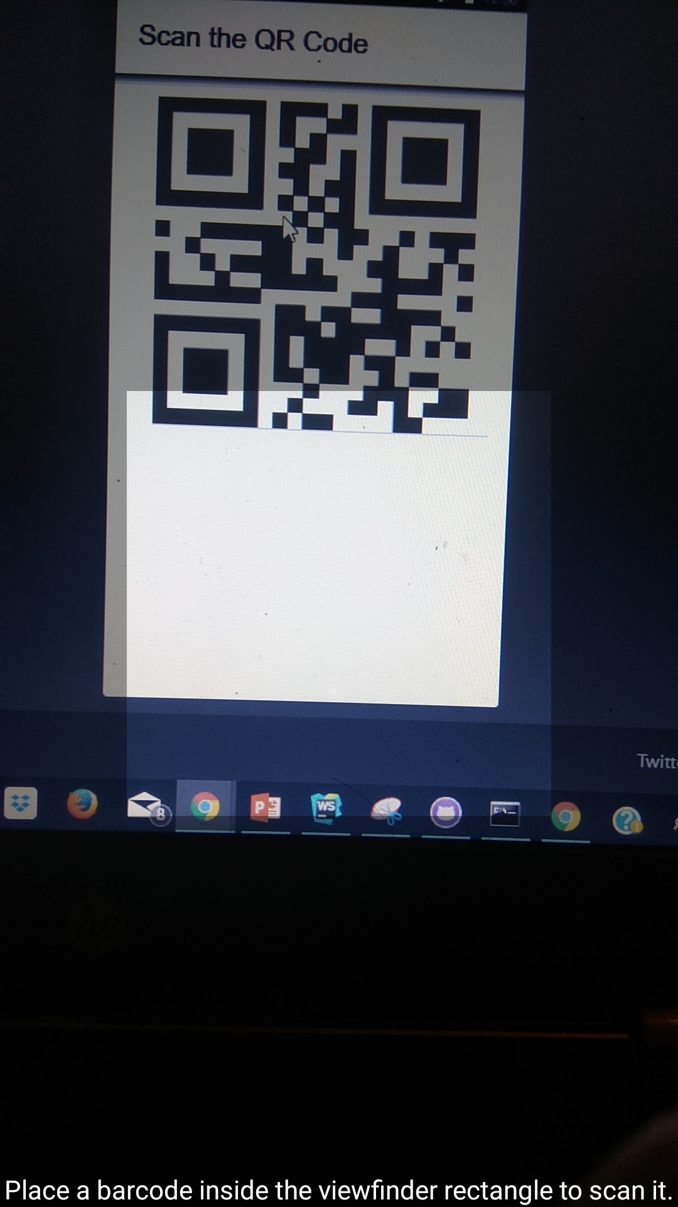
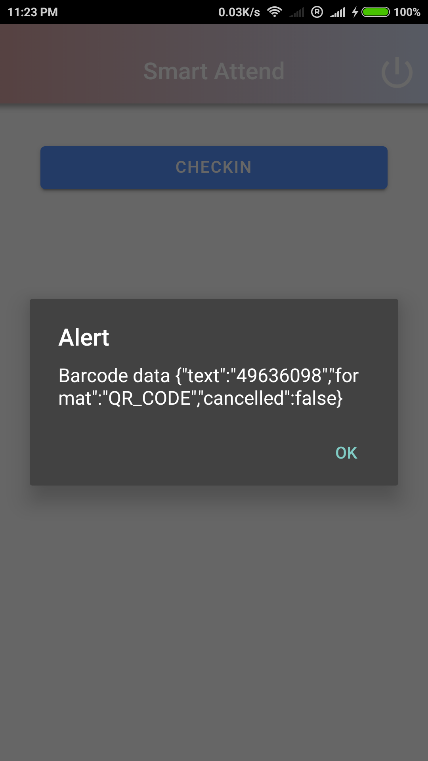
Student Login
Checkin
Scan QR Code
Alert

Slide 11
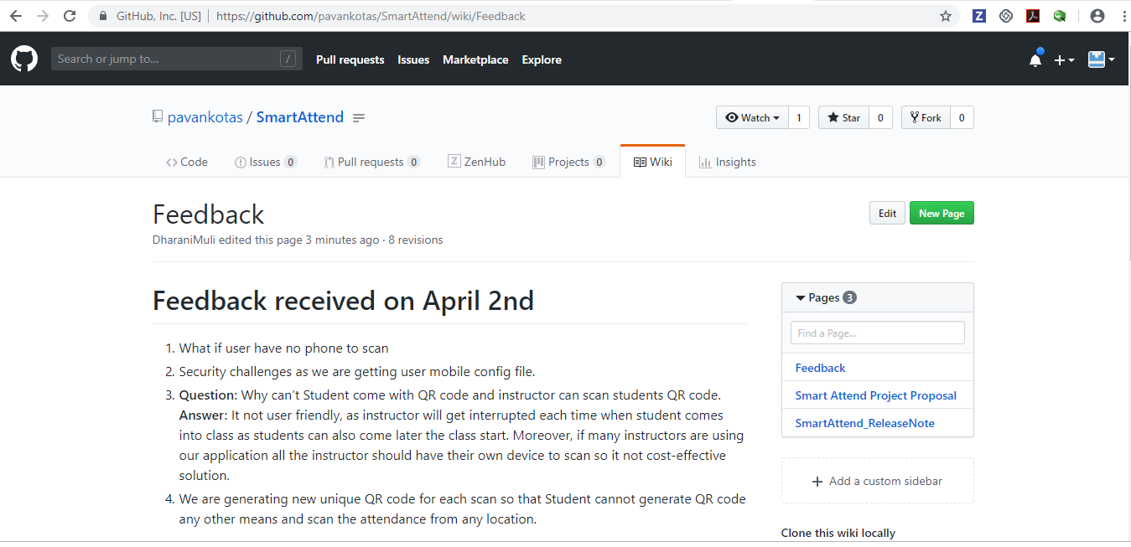

Slide 12
Conclusions from feedback
Future considereation:
Securable application.
User should request instructor to add attendance if they user is unable to take the attendance. Ex: if student don’t have phone.
Late Attendance tracker
Course wise attendance.
Build Statistics
Make Robust
https://github.com/pavankotas/SmartAttend/wiki/Feedback

Slide 13
Journey
Iteration 3: CLosed
Bug Fixes
Test in IOS Phone
UI Level Changes
Detailed Attendance Report for Professor
Implemented loading functionality.
Cloud Deployment
Student should able to use our application and give us the feedback
A follow up meeting with Professor to show the progress and get feedback.
Final Iteration: Closed
Implement changes according to Professor and Students feedback.
Final release
Go Live.

Slide 14
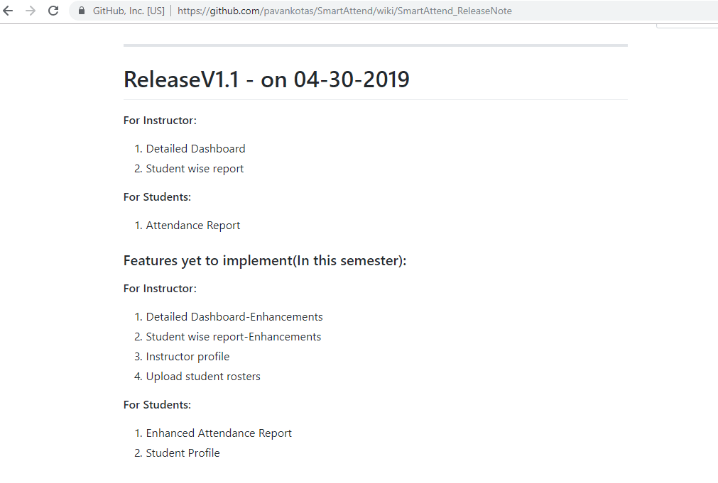
https://github.com/pavankotas/SmartAttend/wiki/SmartAttend_ReleaseNote

Slide 15
Contributions
ROLE OF TEAM MEMBERS:
• Research – Pavan (owner), Dharani
• Documentation – Pavan, Dharani (owner)
• Development – Pavan , Dharani (owner)
• Project Management – Pavan(owner), Dharani

Slide 16
Initial screenhots

Slide 17
Problems that are not solved

Slide 18
Demo Video

Slide 19
Screenshots

Slide 20
EXPECTED PROJECT POUTCOME
1. Build a real time application where in UMKC students and instructors use our application for collaboration, in class attendance maintenance and retrieve analytics on student’s class presence.
2. Should be compatible.
3. Should be cross platform.

Slide 21
Individual learning
:
By end of the project I would like to have hands-on experience on mentioned software tools.
Explore the functionalities of cloud Azure by deploying app services.
I will learn and collaborate efficiently as an individual, as a team.
Dharani, Muli:
From this project I would like to get hands on experience on different tools and technologies like Ionic, firebase, Cassandra and Azure cloud technology.
Also gain knowledge of the best coding standards.
I will improve my collaboration skills working in a team.

Slide 22
Summary/ Conclusion

